Slide 1

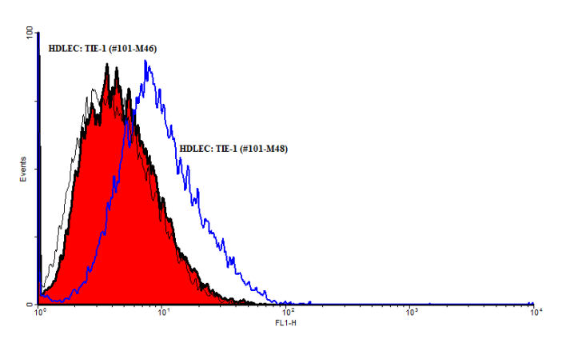
ReliaTech GmbH
Mouse anti-human TIE-1 (#6F12)
(Cat #101-M46 / 101-M48)
Fig. 1: FACS analysis with primary human dermal lymphatic endothelial cells (HDLEC).
http://www.reliatech.de / orders@reliatech.de

